Slide 1


SUD Life
Immediate Annuity Plus
UIN: 142N048V08
A Non-Linked Non-Participating Immediate Annuity Plan
A plan that guarantees happiness
even after retirement
PROTECTING FAMILIES ENRICHING LIVES!

Slide 2




SUD Life Solution
Regular Stream of Income for Senior Citizen post their Retirement
Guaranteed *Life long Income for self and Spouse
Ensure Dependent is financially secured in case of an unfortunate event
*Subject to the policy option chosen

Slide 3


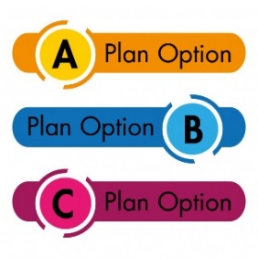



Features
Guaranteed *lifelong income for self & spouse
*Subject to the policy option chosen
Pay *Single Premium and receive income instantly
*Subject to the policy option chosen
Based on the source of income 3 plan options are available:
Namely Plan Option A, Plan Option B and Plan Option C.
There are various Annuity Options available under each of the Plan Option A,B & C
Plan A: All 9 options are allowed
Plan B: Option 2 & 6 are allowed
Plan C: Option 6 by default. If no spouse then option 2 is allowed
Survival Benefit: Annuity will be paid as per the option chosen by annuitant as long as the annuitant(s) is/are alive or till the end of the certain period.
Death benefit will be payable immediately to the beneficiary depending on the Annuity Option chosen.

Slide 4
Plan Options
There are three plan options available under the product based on the source of income to purchase the Annuity plan. Namely Plan Option A, Plan Option B and Plan Option C.
Plan Option A : Immediate Annuity either from savings or policy proceeds of a deferred pension plan/NPS/ open market
Plan Option A
Plan Option B : Immediate Annuity from proceeds from a reverse mortgage loan.
Plan Option B
Plan Option C
Plan Option C : Default Option for NPS subscribers only

Slide 5
Annuity Options under each Plan
Annuity Option
Annuity Name
Description
Plan Option
1
Life Annuity
Life Annuity
Available Under
Plan Option A
2
Life Annuity with Return of Purchase Price
Life Annuity with return of Purchase Price (excluding Taxes if any ) on death of annuitant
Available Under
Plan Option A, B , C
3
Increasing Life Annuity with Return of Purchase Price
Life Annuity increase every year by 5% ( Simple Rate of Interest ) with Return of Purchase Price (excluding taxes, if any) on death of the Annuitant.
Available Under
Plan Option A
4
Joint Life Annuity (50%)
Joint Life Annuity with 50% of Life Annuity payable to the Secondary Annuitant (Spouse) on death of the Primary Annuitant.
Available Under
Plan Option A
5
Joint Life Annuity (100%)
Joint Life Annuity with 100% of Life Annuity payable to the Secondary Annuitant (Spouse) on death of the Primary Annuitant.
Available Under
Plan Option A
6
Joint Life Annuity (100%) with Return of Purchase Price
Joint Life Annuity with 100% of Life Annuity payable to the Secondary Annuitant (Spouse) on death of the Primary Annuitant. and Return of Purchase Price on death of the last survivor.
Available Under
Plan Option A , B , C
* Under Annuity Option 4, 5, and 6, Secondary Annuitant can only be the Spouse of the Primary Annuitant and the Secondary Annuitant at the time of policy commencement cannot be changed subsequently

Slide 6
Annuity Options under each Plan
Annuity Option
Death Benefit
Description
Plan Option
7
Annuity certain for 10 years
Annuity certain for 10 years and for life thereafter
Available Under
Plan Option A
8
Annuity certain for 15 years
Annuity certain for 15 years and for life thereafter
Available Under
Plan Option A
9
Annuity certain for 20 years
Annuity certain for 20 years and for life thereafter
Available Under
Plan Option A

Slide 7


Plan A
There are nine Annuity Options available under Plan Option A.
Under Annuity Option 4, 5, and 6, Secondary Annuitant can only be the Spouse of the Primary Annuitant and cannot be changed subsequently at the time of policy commencement
If Secondary Annuitant dies before the Primary life, the annuity payout will continue to be paid until the Primary Annuitant is alive and the contract ceases immediately after the death of the Primary Annuitant.
*Please note: Annuity Options once chosen cannot be changed subsequently

Slide 8
Plan B
Plan Option B is available only for individuals
Plan Option B is available only for individuals who purchase Immediate Annuity from the proceeds of Reverse Mortgage loan offered by any approved financial institution as mentioned in the Gazette of India.
Individuals aged above 60 years only can avail loans through Reverse Mortgage Loan facility. They can purchase this annuity plan (Plan Option B) through the loan proceeds by submitting a proof of having availed the loan through Reverse Mortgage Loan facility offered by any approved financial institution as mentioned in the Gazette of India.
*Please note: Annuity Options once chosen cannot be changed subsequently

Slide 9
Plan C
Plan Option C is available only for individuals who purchase Immediate Annuity from the proceeds of NPS.
The default annuity option under this plan is the Annuity Option 6, which is “Joint Life Annuity (100%) with Return of Purchase Price”. But, in case, the annuitant does not have a spouse, the annuity benefit will be payable for life of the annuitant as per the Annuity Option 2, which is “Life Annuity with Return of Purchase Price”.
In case the NPS subscriber chooses to opt out of the default options then all the 9 Annuity Options given under Plan Option A are made available
*Please note: Annuity Options once chosen cannot be changed subsequently

Slide 10
Eligibility Criteria
Parameters
Minimum
Maximum
Plan A*
Plan B
Plan C
Age at Entry (Last birthday)
45 Yrs.
60 Yrs.
45 Yrs.
99 Yrs.
Policy Term (years)
Not Applicable as it is an Annuity plan.
Premium Payment Term (years)
This is a single premium plan.
Annuity Payment Modes
Yearly, Half Yearly, Quarterly and Monthly
Minimum applicable Annuity Amounts ( ₹ )#
12000, 6000, 3000 and 1000, respectively.
* For proceeds from deferred pension plan issued by SUD Life Insurance company, Plan A option is only applicable and the minimum entry age is 0 years last birthday
# There is no limit for maximum annuity amount.

Slide 11






How Does This Plan Work?
1
2
3
4
5
Specify the source of premium amount to buy the annuity.
SUD Life deferred pension plan,
Savings,
Open market
Reverse mortgage,
NPS.
Pay the single Premium as chosen and start receiving annuity as per the opted Annuity option and Annuity Frequency.
On the basis of the payment source, choose the annuity option from the available options.
Decide on the frequency of annuity
(Monthly/Quarterly/
Half-yearly/Yearly).
Decide the amount to invest in accordance with the basic eligibility limits.

Slide 12


Survival Benefits
Survival Benefits
Annuity Amount will depend upon
Annuity will be paid as per the option chosen by you as long as the Annuitant(s) is/are alive or
till the end of the certain period (for Annuity Option : 7,8, and 9 ) whichever is later.
Annuity Option chosen,
Age of the annuitant(s),
Annuity Payment Mode and
Amount of the Purchase Price.
Existence certificate must be submitted by the annuitants every year to receive the annuity payouts

Slide 13
Illustration :
The Annuity payable for age 60 Years last Birthday for purchase of ₹ 5,00,000 (excl GST ) Distribution Channel – Corporate Agency is as follows
Annuity Option | Annuity Description | Annually | Half Yearly | Quarterly | Monthly
1 | Annuity for Life | 43,181 | 21,134 | 10,455 | 3,459
2 | Annuity for Life with ROP | 33,842 | 16,563 | 8,194 | 2,711
3 | Increasing Life Annuity for Life with ROP | 25,132 | 12,300 | 6,085 | 2,013
4 | Joint Life Annuity @ 50% | 40,820 | 19,978 | 9,883 | 3,270
5 | Joint Life Annuity @ 100% | 38,953 | 19,065 | 9,431 | 3,120
6 | Joint Life Annuity @ 100% with ROP | 33,805 | 16,545 | 8,185 | 2,708
7 | Annuity Certain for 10 years | 42,458 | 20,780 | 10,280 | 3,401
8 | Annuity Certain for 15 years | 41,704 | 20,411 | 10,097 | 3,340
9 | Annuity Certain for 20 years | 40,784 | 19,960 | 9,874 | 3,267
The Annuity amount increases by 5% p.a ( Simple Rate of Interest ) from Second Policy Year and there after
# Annuity Amount for Primary Annuitant and Secondary Annuitant( Spouse) both aged 60 Years
The Annuity Payout mentioned above is only indicative. The actual Annuity Payout will be as per the rates prevailing at the time of issuance of the Policy.
Minimum Annuity Amount under all Annuity option should be : Yearly – 12000; Half Yearly – 6000; Quarterly – 3000 and Monthly - 1000

Slide 14

Death Benefits
Death Benefits
In the unfortunate event of the death of the Annuitant(s), the death benefit, if any, will be payable to the beneficiary depending on the chosen Annuity option
In case of death of annuitant(s) Purchase Price is returned as death benefits, to the nominee under the Annuity Options 2, 3 and 6
If the annuitant dies during the certain period, annuity payouts will be paid for the balance period to the nominee under the options 7, 8 & 9

Slide 15
Death Benefit
Annuity Option
Description
Death Benefit
1
Life Annuity
Nil
2
Life Annuity with return of Purchase Price (excluding Taxes if any ) on death of annuitant
Purchase Price Excluding taxes if any
Rs.5 Lakhs payable to Nominee#
3
Life Annuity increase every year by 5% ( Simple Rate of Interest ) with Return of Purchase Price (excluding taxes, if any) on death of the Annuitant.
Purchase Price Excluding taxes if any
Rs.5 Lakhs payable to Nominee#
4
Joint Life Annuity with 50% of Life Annuity payable to the Secondary Annuitant (Spouse) on death of the Primary Annuitant.
Nil
5
Joint Life Annuity with 100% of Life Annuity payable to the Secondary Annuitant (Spouse) on death of the Primary Annuitant.
Nil
6
Joint Life Annuity with 100% Annuity payable to the Secondary Annuitant on death of the Primary Annuitant and Return of Purchase Price on death of the last survivor.
Purchase Price Excluding taxes if any
Rs.5 Lakhs payable to Nominee#
7
Annuity certain for 10 years* and for life thereafter
Nil
Annuity for balance of certain period
8
Annuity certain for 15 years* and for life thereafter
Nil
Annuity for balance of certain period
9
Annuity certain for 20 years* and for life thereafter
Nil
Annuity for balance of certain period
* In case of death of the annuitant during the certain period, annuity payouts for the balance period will be paid to the nominee under the options 7, 8 & 9.
# Assuming Purchase Price to be Rs. 5 Lakhs

Slide 16
Additional Features
Free Look Period:
The Annuitant has a period of 30 (Thirty) days from the date of the receipt of the Policy document to review the terms and conditions.
List of Critical Illness covered:
Cancer of Specified Severity
Myocardial Infarction (First Heart Attack - of Specified Severity)
Stroke Resulting in Permanent Symptoms
Open Chest CABG
Kidney Failure Requiring Regular Dialysis
Multiple Sclerosis With Persisting Symptoms
Major Organ /Bone Marrow Transplant
Open Heart Replacement or Repair of Heart Valves
Coma of Specified Severity
Permanent Paralysis of Limbs
Motor Neurone Disease with Permanent Symptoms
Surrender Benefit:
Surrender Benefit* is available only for Annuity Option 2, Annuity Option 3 and Annuity Option 6 on happening of the specified events mentioned in the policy brochure or the Annuitant is diagnosed with any one of the Critical Illnesses mentioned in the policy document. Please refer to policy document on website.
*Surrender value payable is dependant on the year of surrender. If Surrendered between 0 to 3 policy years – 95% of Purchase Price, 4th to 10th policy year – 98% of Purchase Price and 11th year afterwards – 100% of Purchase Price is payable

Slide 17
High Purchase Price Benefit:
In case of High Purchase Price, the Tabular Annual Annuity Rate will be increased by certain percentage of High Purchase Price Benefit. The High Purchase Price Benefit as a percentage of Tabular Annual Annuity Rates is given below.
Purchase Price
High Purchase Price Benefit
Less than 5 Lacs
0%
5 Lacs to less than 10 Lacs
3%
10 Lacs to less than 25 Lacs
4%
25 Lacs to less than 45 Lacs
4.50%
45 Lacs and above
5.50%

Slide 18

Key Points
Key Points
Non-Linked Non-Participating Immediate Annuity Plan
Guaranteed *lifelong income for self & spouse
*Subject to the chosen annuity option
Pay Single premium and start receiving income instantly
There are three plan options available under the product based on the source of income to purchase the Annuity plan.
Plan A - Immediate Annuity either from savings or policy proceeds of a deferred pension plan/NPS
Plan B - Immediate Annuity from Proceeds of a Reverse Mortgage Loan offered by any approved financial institution
Plan C - Default option for National Pension Scheme subscribers
Tax Benefit under section 80C and Section 10(10D)
Disclaimer:
Tax benefit may be available on the premiums paid and benefits received as per prevailing tax laws
Notes:
Recap of the Plan Benefits

Slide 19
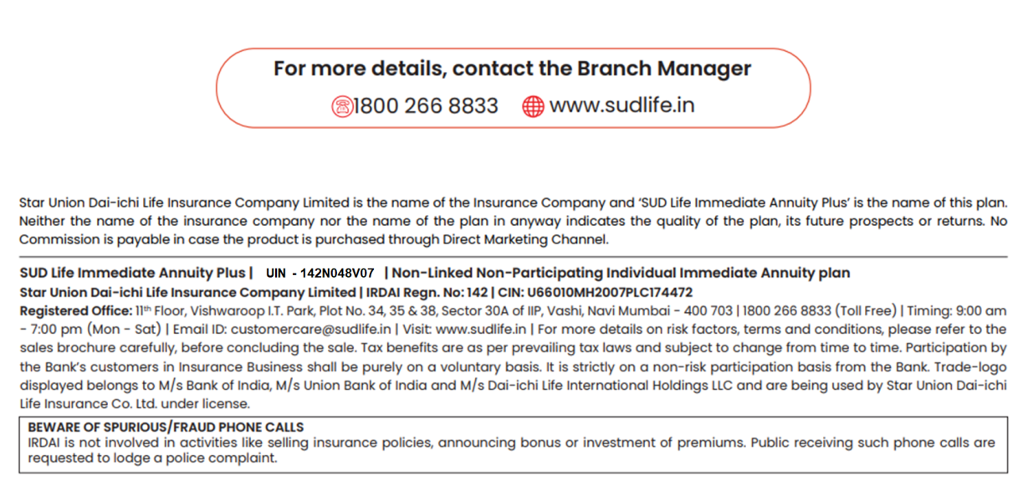
Disclaimer
Key Points
UIN – 142N048V08
Notes:
Recap of the Plan Benefits

Slide 20



